Slide 1
Customer Classification and Room Optimization for Hotels Results produced by: Kenny Thomas, Jessie Tolbert, Doug McGuire, Kyle Johnson

Slide 2
OVERVIEW
Introduction to the dataset
Proposition
Data Cleaning Process
Model Application
Findings
Further Studies

Slide 3
Data Introduction
1

Slide 4
COLLECTION
Data was collected from five different hotels (same chain)
Rooms were booked through 3 mediums: CRO/Hotel, Web, and GDS
Focused on transient business who stayed less than 7 nights

Slide 5
RATE CODES
This project explores the flexibility of rate code selection
Each hotel has a unique set of rate codes
Rate codes differ from hotel to hotel, excluding rate 2 which is the unrestricted rack rate

Slide 6
RATE CODES : EXAMPLE
Hotel One:
Hotel Two:
Rate 1- Advance Purchase - Requires 10-day Advance Purchase, Fully Restricted Rate
Rate 2 -Rack Rate - Unrestricted Rate
Rate 3 -Rack Rate Combined with Additional Hotel Services
Rate 4 -Accommodation Combined with In City Activities (e.g., golfing, etc.)
Rate 5 -Accommodation Combined with In City Activities (e.g., shopping, dining, etc.)
Rate 6 -Accommodation Combined with Weekend Activities Rate
Rate 7 -Accommodation Combined with Special Event Activities (e.g., visits to museums, tickets to concerts, etc.)
Rate 8- Accommodation Combined with Frequent Traveler Rewards
Rate 1- Advance Purchase -Requires 14-day Advance Purchase, Fully Restricted Rate
Rate 2 -Rack Rate - Unrestricted Rate
Rate 3 -Accommodation Combined with Frequent Traveler Rewards
Rate 4 -Discount Rate Less Restricted Than Advance Purchase
Rate 5 -Discount Rate Less Restricted Than Advance Purchase
Notes:
All have a different amount of rate codes

Slide 7
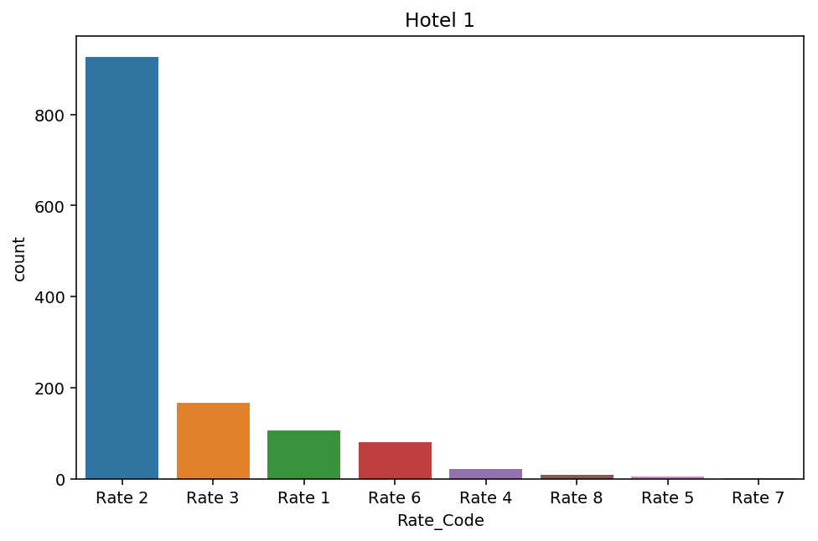
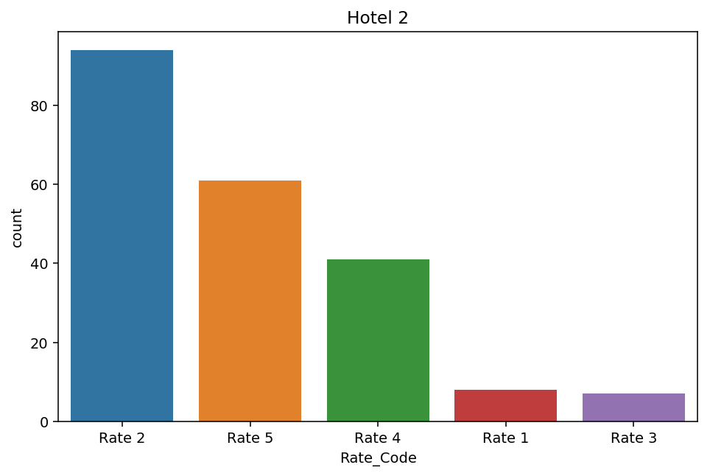
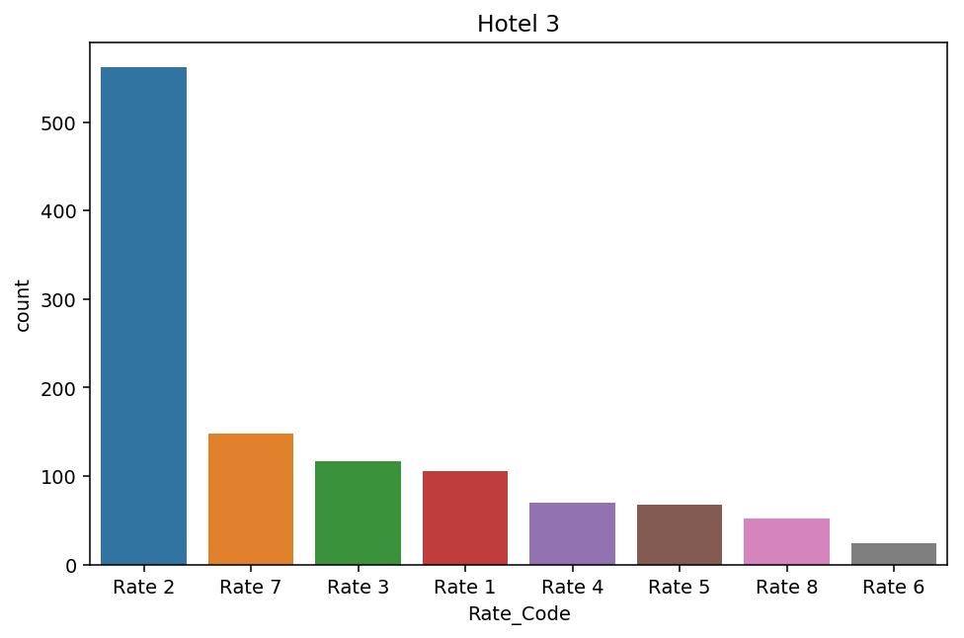
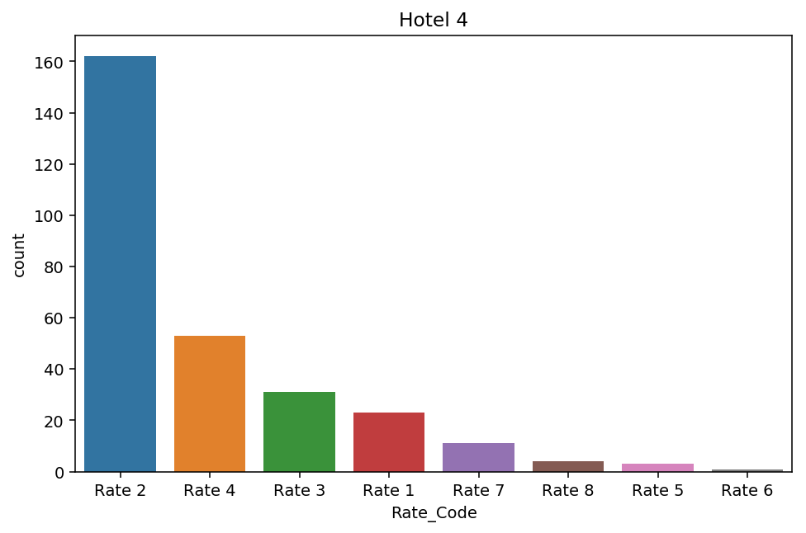
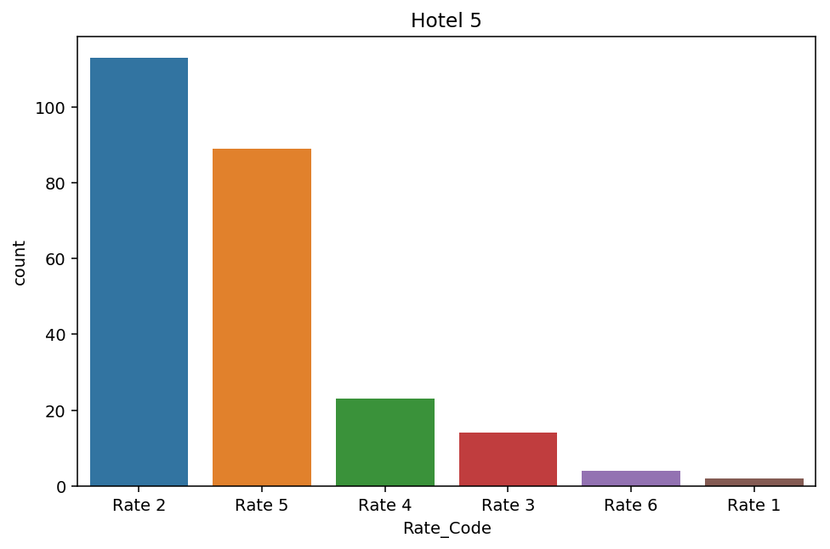
Rate Code Distributions

Slide 8
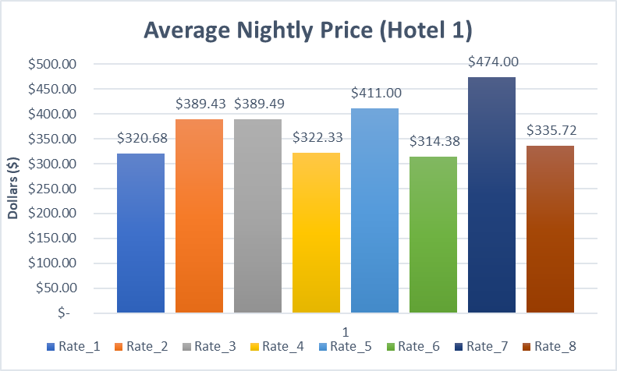
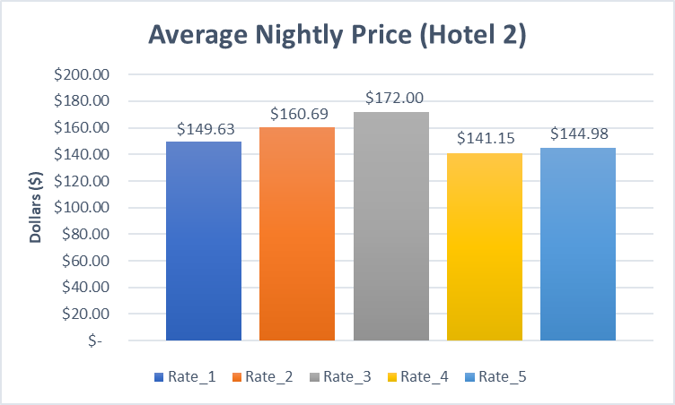
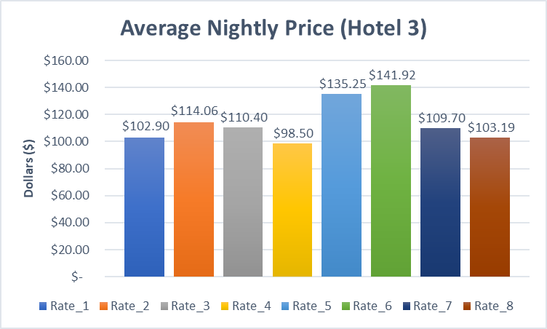
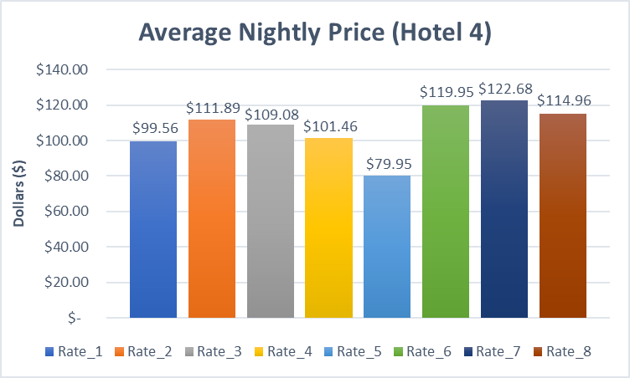
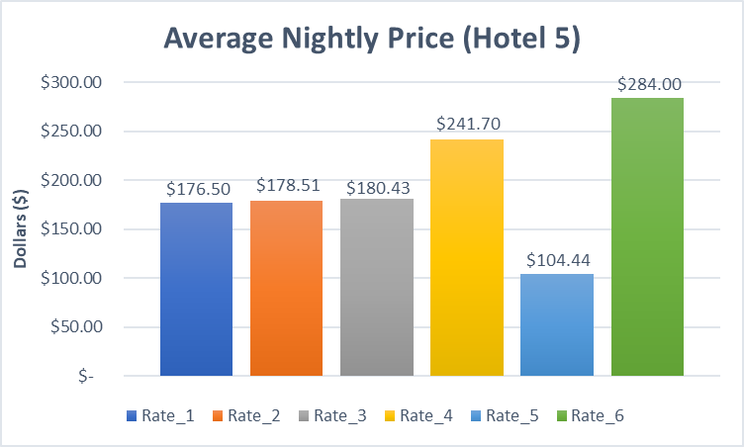
Average Nightly Price by Rate Code

Slide 9
Rate 2 is the most common rate purchased at all five hotels BUT it does not necessarily bring in the most revenue
Rate Code Distributions Conclusion:

Slide 10
Proposition

Slide 11
EXPLORATION
Question:
Can we improve expected revenue by analyzing customers’ rate code selection probabilities?
Procedure:
Build a classication model which returns each customers’ probability of booking a certain rate code
Explore instances where expected revenue would be higher
Build specified recommendations

Slide 12
CLEANING
2

Slide 13
OUR PROCESS IS EASY
CLEAN
FIT
BIN

Slide 14
CLEAN
FIT
BIN
Only include data where a room was actually purchased
Applied one hot encoding methods for binary and multiple categorical values
e.x. VIP Membership Status
Isolated data for each hotel
CLEAN

Slide 15
CLEAN
FIT
BIN
Split data into train and test sets
Mitigates overfitting and other biases
Test a variety of classification models and evaluate performance
FIT

Slide 16
CLEAN
FIT
BIN
Group data by Rate Code
Isolate instances where expected profit could be improved
Bin results by hotel and rate code segment
BIN

Slide 17
MODEL FITTING
3

Slide 18
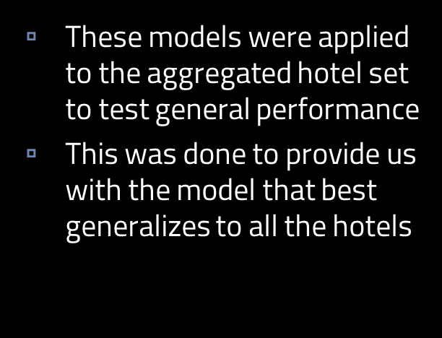
DIFFERENT FITS
RANDOM FORREST
ACCURACY: 65%
NEURAL NET
ACCURACY: 47%
KNN
ACCURACY: 55%

Slide 19
RANDOM FOREST OPTIMIZATION
What does it look like?

Slide 20
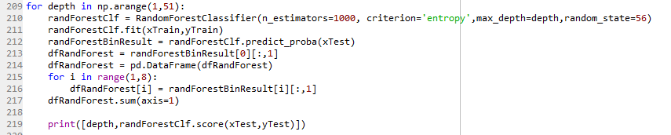
RANDOM FOREST OPTIMIZATION
What does it look like?

Slide 21
FITTING
The best model type from the previous step was then fitted to each individual hotel
Features in the models were all kept the same
Predicted the probability of the customers choosing each rate code
Returned a data frame of the random forest results
Meaning a probability matrix for each rate
Done for each hotel
Accuracy increased compared to the aggregate model

Slide 22
RANDOM FOREST PERFORMANCE MEASURE
 | Approx. Accuracy
Hotel 1 | 72%
Hotel 2 | 77%
Hotel 3 | 66%
Hotel 4 | 90%
Hotel 5 | 89%

Slide 23
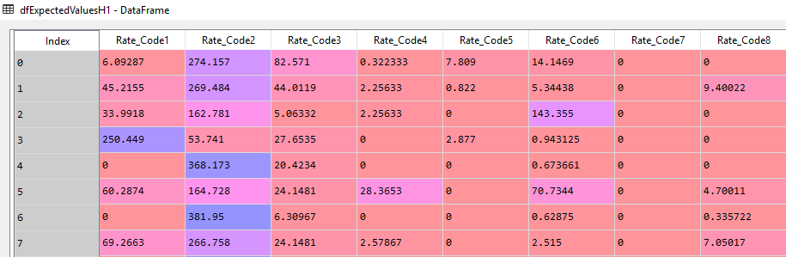
USING RANDOM FOREST RESULTS
Use average nightly rates for each rate code
Multiply average rates by random forest rate code probabilities
Returns a matrix of expected values for each customer
Rate | Average Night Rate
Rate1 | 320.677
Rate2 | 389.427
Rate3 | 389.486
Rate4 | 322.333
Rate5 | 411
Rate6 | 314.375
Rate7 | 474
Rate8 | 335.722

Slide 24
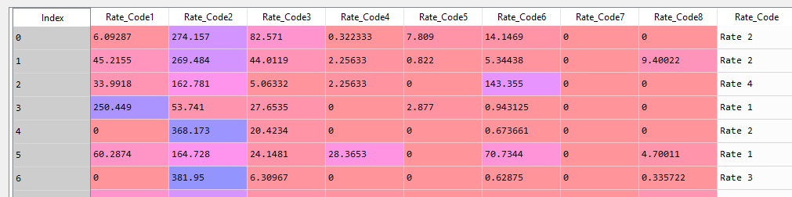
USING THE EXPECTED VALUES
Run profit differential function
Identifies the maximum expected value
Identifies the expected value for rate code actually purchased
Sums the difference

Slide 25
EXPECTED IMPROVEMENT PER CUSTOMER
Hotels 1 and 3 would benefit the most in expected revenue by using our model
Hotel 4 appears to be offering most of their customers the appropriate rates
Hotel | Expected Revenue Increase per Customer | Expected Revenue Increase
Hotel1 | 37.97 | 14,999.75
Hotel2 | 8.55 | 547.4
Hotel3 | 9.81 | 3,384.18
Hotel4 | 1.98 | 172.15
Hotel5 | 10.24 | 757.57

Slide 26
INSIGHTS
4

Slide 27
BINS
Once the expected profit increase was found, we decided to further explore how to specifically help each hotel
If there was an improvement to be made, we binned the actual rate code chosen with the suggested rate code based off our model
First row is actual selected.
Each other row is a suggestion
E.G. of the 35 that chose rate 1, 15 should be pushed to rate 2
Hotel 1 →
Recommendation | Count
Actual: | [35, 275, 53, 10, 2, 18,1,1]
Push Rate1 | [20, 15, 0, 0, 0, 0, 0, 0]
Push Rate2 | [2, 265, 7, 0, 0, 1, 0, 0]
Push Rate3 | [1, 43, 9, 0, 0, 0, 0, 0]
Push Rate4 | [0, 9, 1, 0, 0, 0, 0, 0]
Push Rate5 | [0, 2, 0, 0, 0, 0, 0, 0]
Push Rate6 | [2, 8, 0, 0, 0, 8, 0, 0]
Push Rate7 | [0, 1, 0, 0, 0, 0, 0, 0]
Push Rate8 | [0, 1, 0, 0, 0, 0, 0, 0]

Slide 28
HOTEL 1 BREAKDOWN
Increase rack rate
Reduce
Rate 3
Focusing on the rack rate is ideal.

Slide 29
HOTEL 3 BREAKDOWN
Increase emphasis
Rack rate
rate 3
rate 7

Slide 30
HOTEL 4 BREAKDOWN
Increase rack rate
Decrease:
Rate 3
Rate 4
Spread out emphasis on rate code 7 to include rate code 8

Slide 31
LIMITATIONS
Overall, we see that the model tends to push an expansion of the rack rate
This is due to the fact that transient business class was focused on for data collection

Slide 32
FURTHER STUDIES
Expanding the customer base
Inclusion of costs
Inclusion of different segmented prices
Availability to customers who browsed but did not purchase

Slide 33
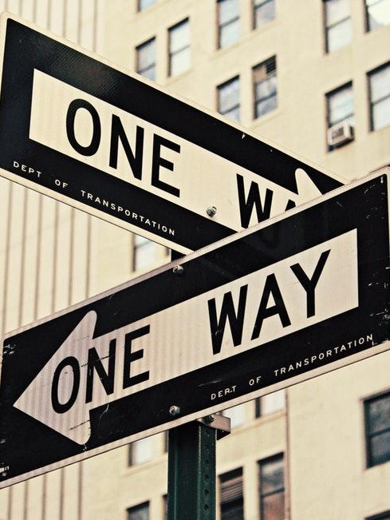
THANKS!
Any questions?

